Slide 1
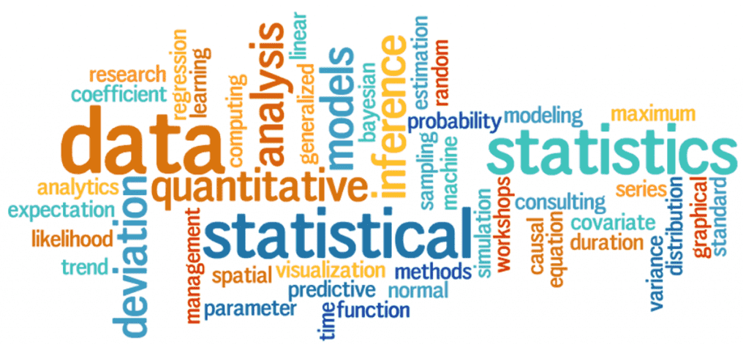
Introduction to Statistics
Statistics
Statistics is a mathematical science pertaining to the collection, presentation, analysis and interpretation of data.
        figure 1

Slide 2
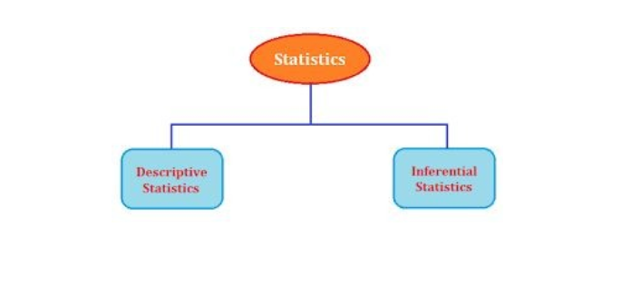
Types of Statistics
Statistics

Slide 3
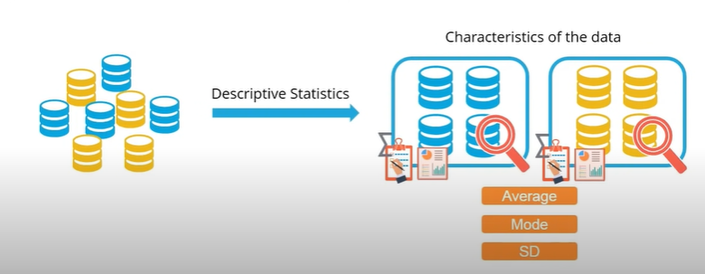
Descriptive Statistics
Statistics
Descriptive Statistics helps organize data and focus on the main characteristics of the data.
It provides a summary of the data numerically or graphically.

Slide 4
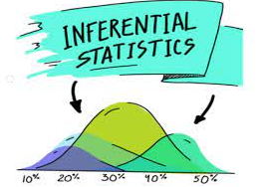
Inferential Statistics
Statistics
Inferential Statistics generalize the larger dataset and applies probability theory to draw a conclusion.
It allow you to infer population parameter based on sample statistics and to model relationship with in data.

Slide 5
Categories Descriptive Statistics
Statistics
Divided into three sub-categories
Measure of Central Tendency(Mean, Median, Mode)
Measure of Variability/Spread ( Range, variance, standard deviation, skewness)
Measure of relationship between variables (covariance and correlation)
.

Slide 6
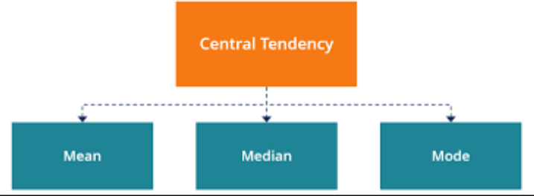
Measure of Central Tendency
Statistics

Slide 7
Mean
Statistics
The mean is the average of a data set.
The average of two cricketers
Baber Azam = 50,60,90,10,40 = 50+60+90+10+40 /5= 50.0
M. Rizwan= 70,40,30,35,25= 70+40+30+35+25/5= 40.0
It is affected by extreme values (outliers). Very large or very small numbers can distort the answer

Slide 8
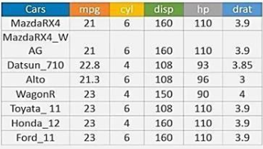
Median
Statistics
It is the middle value. To find out the center value of mpg for the population of cars, arrange all the values in ascending order. 21,21,21.3,22.8,23,23,23,23. In case of even values, take the average of the middle two values. (22.8+23)/2 = 22.9
It is NOT affected by extreme values. Very large or very small numbers do not affect it

Slide 9
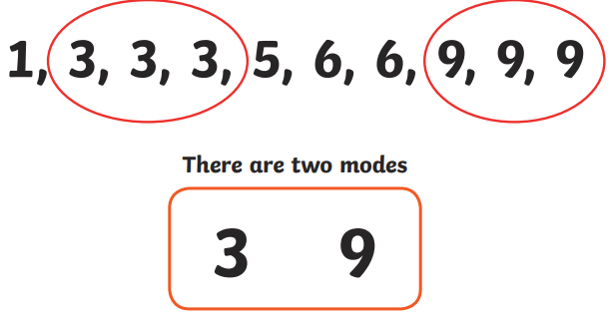
Mode
Statistics
It is the value that occurs most frequently in a dataset.

Slide 10
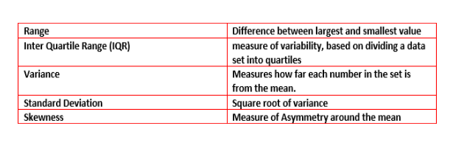
Measures of Variability/Spread
Statistics

Slide 11
Range
Statistics
Represents the difference between the low and high value in data.
Calculation: R = High – Low
    Example: In {4, 6, 9, 3, 7} the lowest value is 3, and the highest is 9.
So the range is 9 − 3 = 6.

Slide 12
Range Can be Misleading
Statistics
The range can sometimes be misleading when there are extremely high or low values. (Outliers)
Example: In {8, 11, 5, 9, 7, 6, 3616}: the lowest value is 5, and the highest is 3616.
So the range is 3616 − 5 = 3611.
The single value of 3616 makes the range large, but most values are around 10.
We can use interquartile range instead.

Slide 13
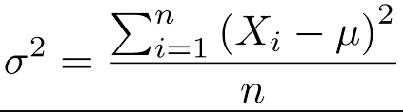
Variance
Statistics
It measures how far a set of numbers is spread out from their average value.

Slide 14
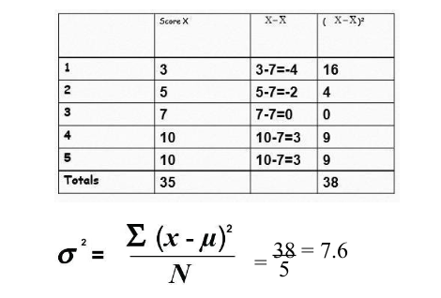
Calculating Variance
Statistics

Slide 15

Standard Deviation
Statistics
In order to get rid of the “square” (which does not make any sense) variance, we take a square root of the variance.
Tells us the same thing as variance.

Slide 16
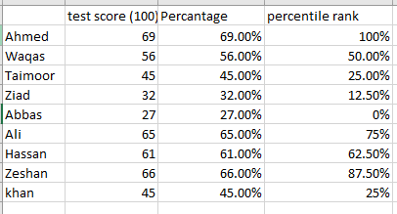
What is percentile?
Statistics
The percentile usually indicates that a certain percentage falls below that percentile. For example,.

Slide 17
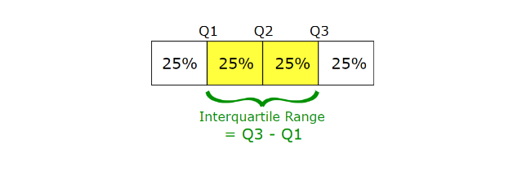
Interquartile Range (IQR)
Statistics
IQR is useful because it is less influenced by extreme values as it limits the range to the middle 50% of the values.

Slide 18
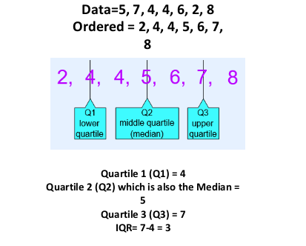
Example
Statistics
Lower Limit=Q1-1.5*IQR = -0.5
Upper Limit=Q3 + 1.5*IQR= 11.5

